Slide 1
Smart Manufacturing Pilot Use Case 2: Threat Detection & Isolation

Slide 2
Use Case 2: Threat Detection & Isolation
Situation: Machines running & collecting data
Goals of use case 2:
Monitor machines in production
Automatically detect problems → Here: Detect intrusion
Automatically resolve problems → Here: Isolate intruded machine
Challenges:
Real-time monitoring
Cloud-native intrusion detection system (IDS)
Flexible reconfiguration of services and CNFs
Automation of threat detection & isolation
Notes:
UC1: saw how easy it is to setup new manufacturing machines, connect them, collect their data
UC2: Machines are running & data being collected → make sure it stays that way (stable)
Ex: Attacker wants to intrude (access/modify data)

Slide 3
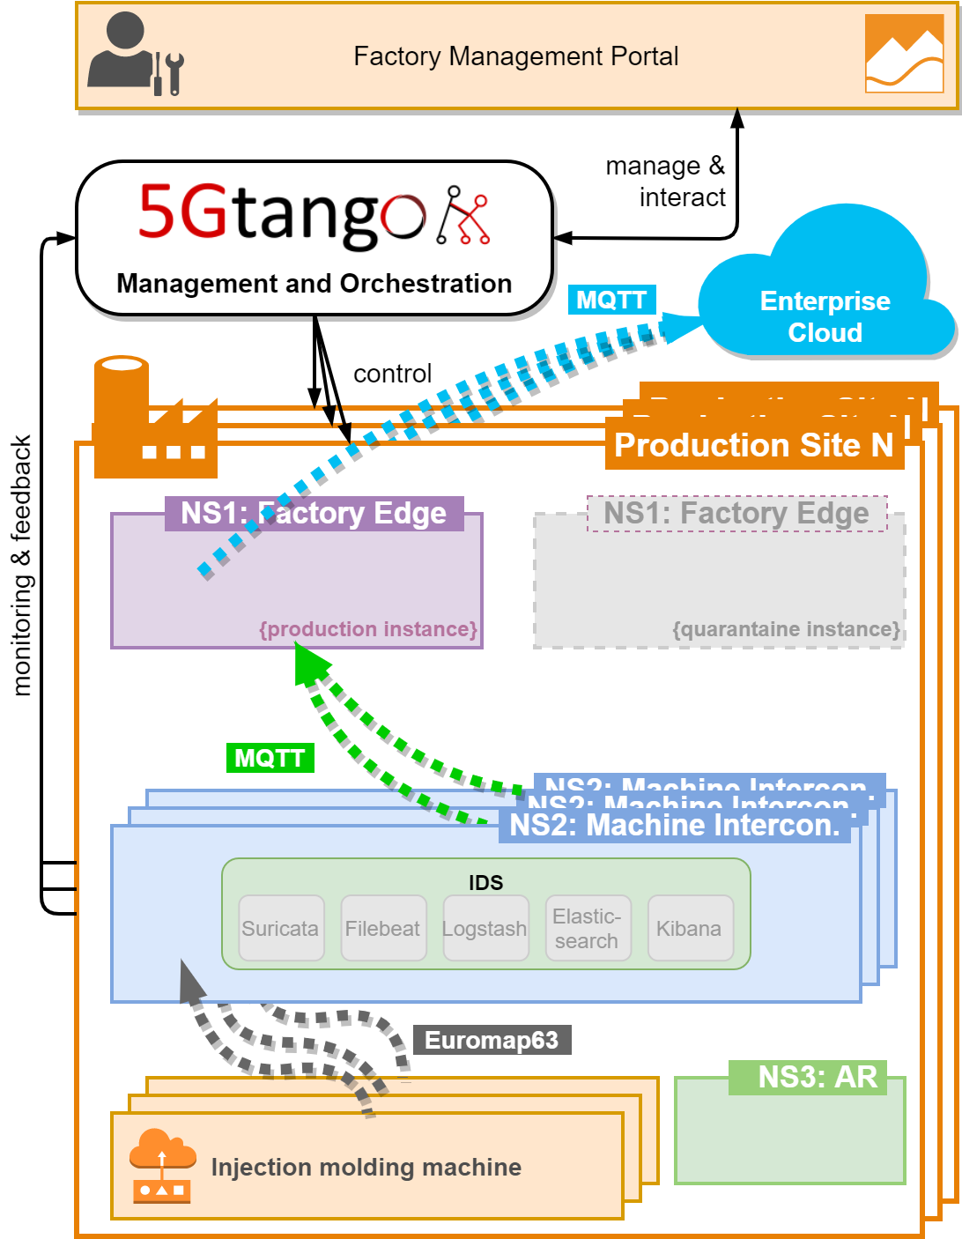
High-Level Architecture
New in use case 2:
Intrusion Detection System (IDS)
Quarantine NS1
Normal production:
Data arrives in production NS1
Intrusion!
Notes:
Normal production: Machine → NS2 → NS1 → Cloud
Intrusion: Ensure no malicious data is sent to NS1 and cloud
But also don’t throw data away → analyze, debug, maybe merge later → Quarantine NS1

Slide 4
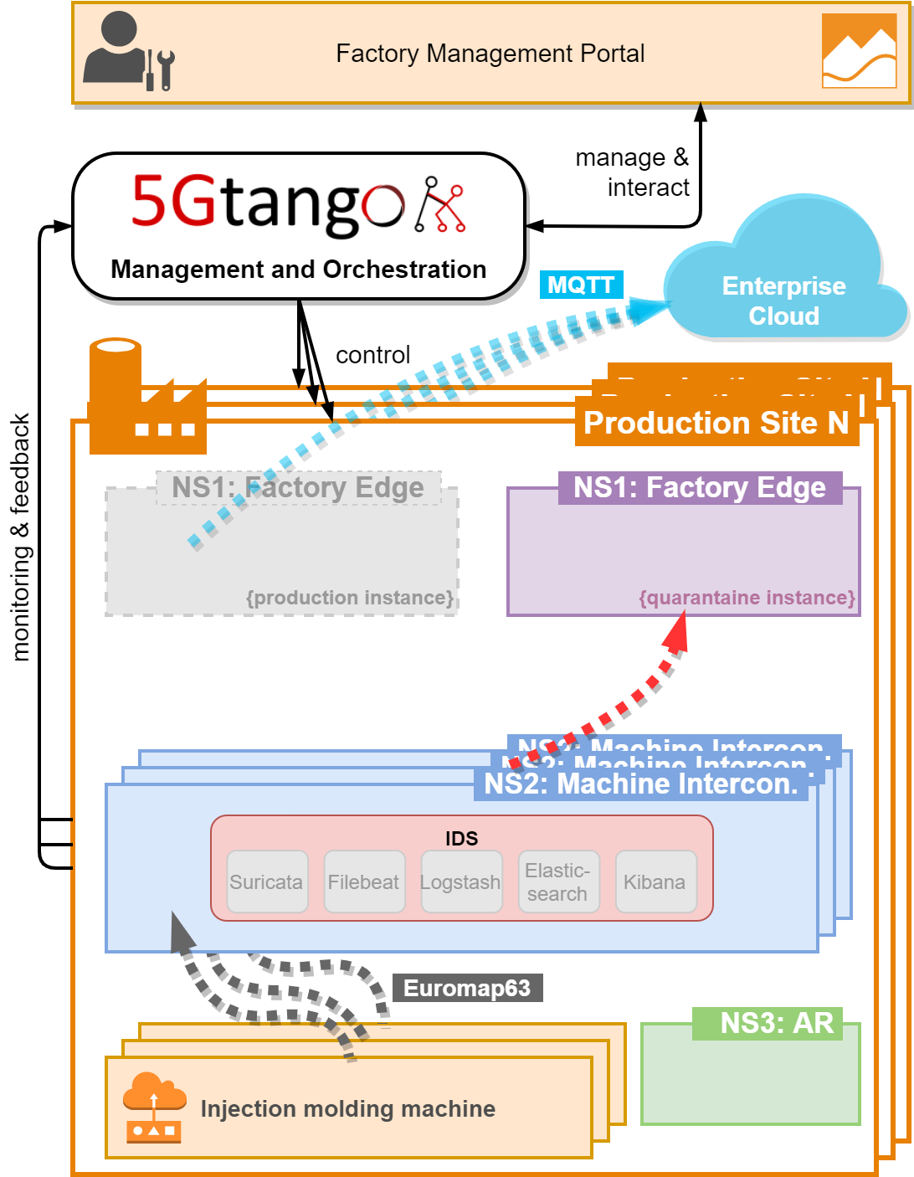

High-Level Architecture
New in use case 2:
Intrusion Detection System (IDS)
Quarantine NS1
Normal production:
Data arrives in production NS1
Intrusion:
Intrusion detected by IDS
NS2 reconfigured
Data arrives in quarantine NS1
→ Threat detected & contained
Intrusion!
Notes:
→ data isolated → threat contained → data still available for analysis

Slide 5
Details: Intrusion Detection & Reconfiguration
5GTANGO Service Platform
Function Lifecycle Manager
Service Lifecycle Manager
Func.-Spec. Manager (MDC)
Reconf.
Event
(MDC)
Service-Spec. Manager
(NS2)
Policy Manager
Alarm Trigger
Monitoring Manager
Reconf.
Trigger
Reconfigure MDC CNF
NS2: Machine Interconnection
IDS
(Suricata + ELK)
Machine Data
Collector (MDC)
Machine Data
Intrusion!
IDS Alarm Metric
NS1 (Production)
NS1 (Quarantine)
NS1 (Production)
NS1 (Quarantine)
Notes:
Realize flexible, automated detection & reconfig via 5GTANGO SP → multiple advanced components play together
Innovative features: Programmability & flexibility of FSM/SSM, Run-time actions via policies
Powerful → could also be used for more complex attacks/actions based on monitoring data

Slide 6
Demo Steps
Starting point:
Normal & Quarantine NS1 running
NS2 running and machine connected, sending data
Intrusion attempt by attacker
IDS notices intrusion and triggers alert
NS2 is reconfigured to send data into quarantine NS1
→ Threat detected & isolated!

Slide 7
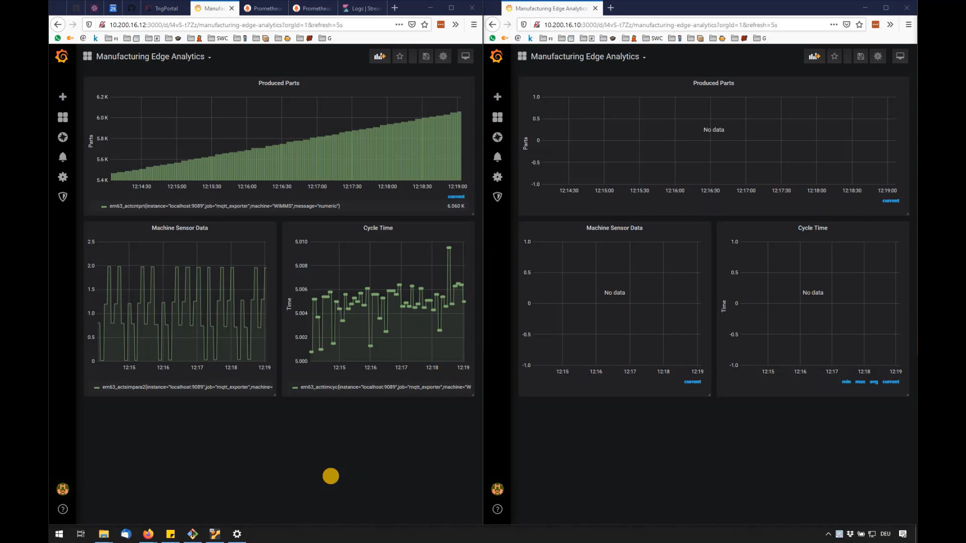
Starting point: Machines in Production
Normal NS1
Quarantine NS1
Notes:
normal: data arrives in normal NS1 (left)
not quarantine (right)

Slide 8
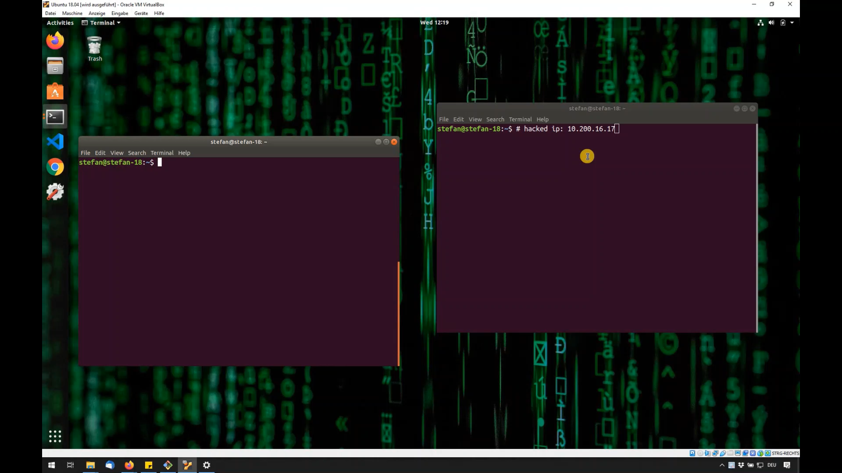
Intrusion Attempt by Attacker
Notes:
attacker already in factory network and IP of NS2
open ports → Samba → connect

Slide 9
Details: Intrusion Detection & Reconfiguration
5GTANGO Service Platform
Function Lifecycle Manager
Service Lifecycle Manager
Func.-Spec. Manager (MDC)
Reconf.
Event
(MDC)
Service-Spec. Manager
(NS2)
Policy Manager
Alarm Trigger
Monitoring Manager
Reconf.
Trigger
Reconfigure MDC CNF
NS2: Machine Interconnection
IDS
(Suricata + ELK)
Machine Data
Collector (MDC)
Machine Data
Intrusion!
IDS Alarm Metric
NS1 (Production)
NS1 (Quarantine)
NS1 (Production)
Notes:
intrusion → detected by IDS

Slide 10
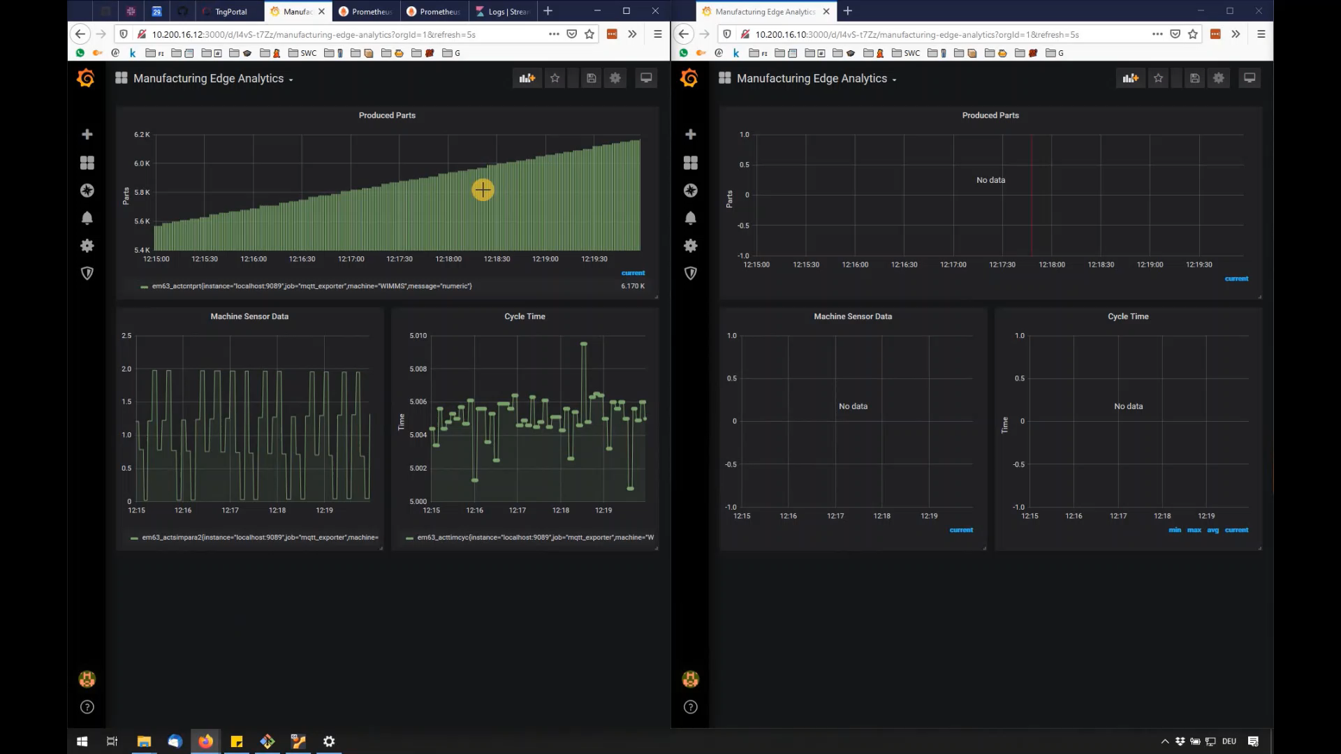
Intrusion Detection by IDS
Notes:
dashboard shows intrusions
IDS shows intrusion characteristics
eg, username of intruder

Slide 11
Details: Intrusion Detection & Reconfiguration
5GTANGO Service Platform
Function Lifecycle Manager
Service Lifecycle Manager
Func.-Spec. Manager (MDC)
Reconf.
Event
(MDC)
Service-Spec. Manager
(NS2)
Policy Manager
Alarm Trigger
Monitoring Manager
Reconf.
Trigger
Reconfigure MDC CNF
NS2: Machine Interconnection
IDS
(Suricata + ELK)
Machine Data
Collector (MDC)
Machine Data
Intrusion!
IDS Alarm Metric
NS1 (Production)
NS1 (Quarantine)
NS1 (Production)
Notes:
IDS sets alarm metric
alert triggered in monitoring system

Slide 12
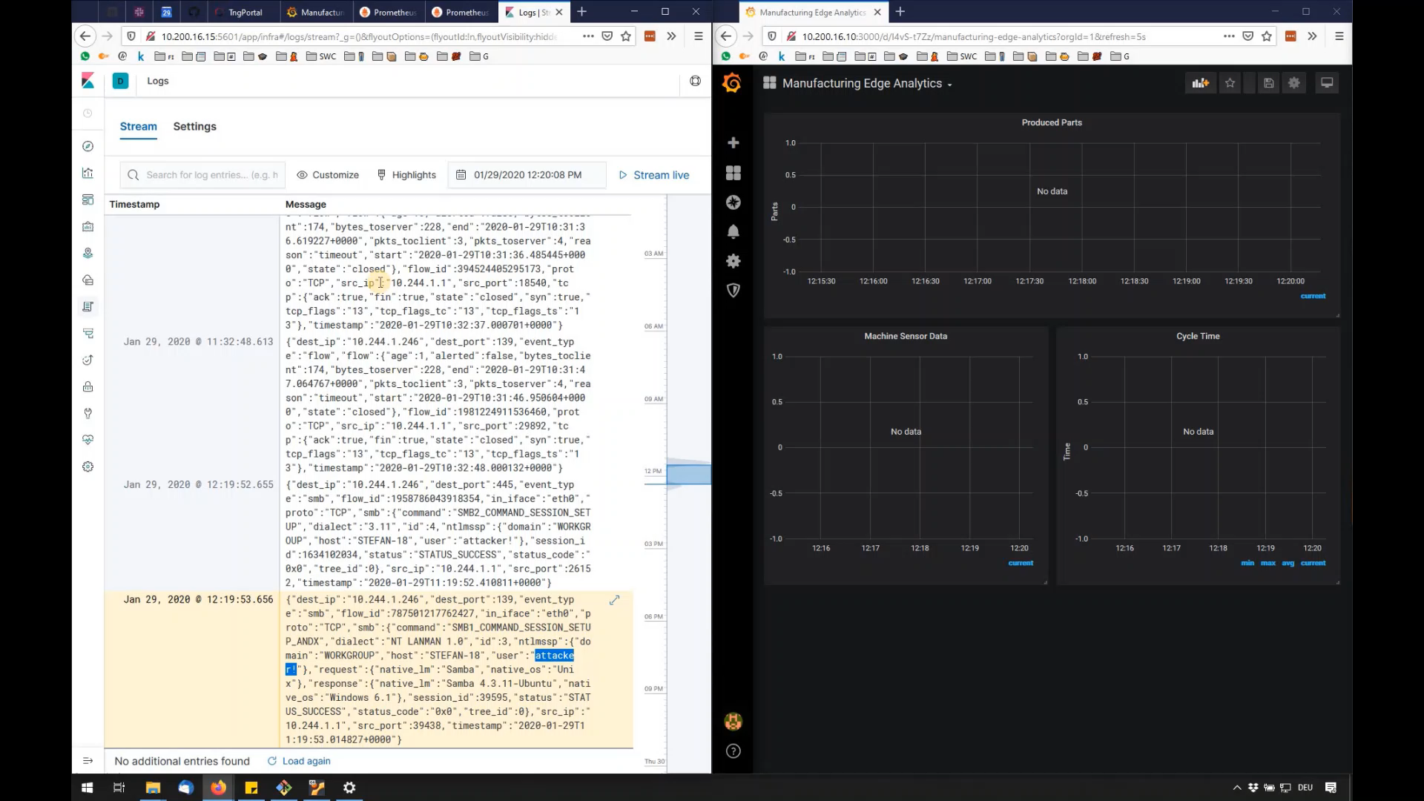
Intrusion Alert
Notes:
monitoring rule through policy
green → red = intrusion alarm, trigger reconifg

Slide 13
Details: Intrusion Detection & Reconfiguration
5GTANGO Service Platform
Function Lifecycle Manager
Service Lifecycle Manager
Func.-Spec. Manager (MDC)
Reconf.
Event
(MDC)
Service-Spec. Manager
(NS2)
Policy Manager
Alarm Trigger
Monitoring Manager
Reconf.
Trigger
Reconfigure MDC CNF
NS2: Machine Interconnection
IDS
(Suricata + ELK)
Machine Data
Collector (MDC)
Machine Data
Intrusion!
IDS Alarm Metric
NS1 (Production)
NS1 (Quarantine)
NS1 (Quarantine)
Notes:
reconfig through SP
then send data to quarantine

Slide 14

Isolation of Intruded Machine
Threat detected & contained!
Notes:
data stops arriving in normal NS1
starts arriving in quarantine NS1
→ isolated → success

Slide 15
Alternative: Manual Isolation
Factory staff notices anomaly → Trigger isolation through FMP
Later: Deisolation
Manual
Trigger
SMP-CC
Reconf. Trigger
FMP
Staff
Reconf.
Trigger
5GTANGO Service Platform
Function Lifecycle Manager
Service Lifecycle Manager
Func.-Spec. Manager (MDC)
Reconf.
Event
(MDC)
Service-Spec. Manager
(NS2)
Policy Manager
Monitoring Manager
Reconf.

Slide 16
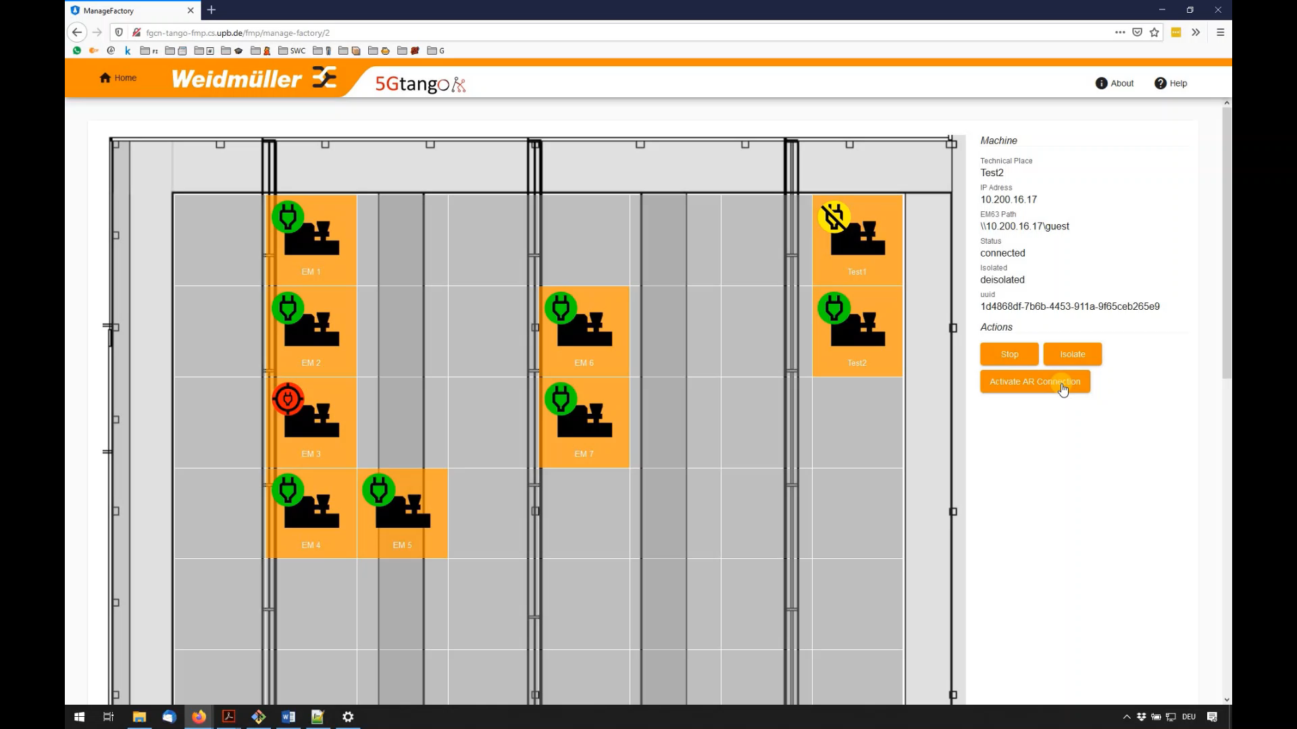
Alternative: Manual (De-)Isolation

Slide 17
Use Case 2: Conclusions
Real-time monitoring of production machines
Automatic intrusion detection
Automatic reconfiguration and machine isolation
Alternative: Manual isolation & deisolation
Enabled by 5GTANGO service platform advanced features
→ Uninterrupted & secure production → Reduced risk & costs

Slide 18
Thank You!

Slide 19
Details: Intrusion Detection & Reconfiguration
5GTANGO Service Platform
FSM (MDC)
SSM (NS2)
Reconf.
Task
(MDC)
Reconf.
Event
Reconf.
Result
(MDC)
Reconf.
Event
Reconf.
Event
(MDC)
Policy Manager
Alarm Trigger
Monitoring Manager
FLM
SLM
Reconf.
Trigger
Reconfigure MDC CNF
NS2: Machine Interconnection
IDS
(Suricata + ELK)
Machine Data
Collector
Machine Data
Intrusion!
IDS Alarm Metric
to NS1 (Production)
to NS1 (Quarantine)
Notes:
Realize flexible, automated detection & reconfig via 5GTANGO SP → multiple advanced components play together
Start: NS2 (IDS, MDC) → NS1
Powerful → could also be used for more complex attacks/actions based on monitoring data

Slide 20
Details: Intrusion Detection & Reconfiguration
5GTANGO Service Platform
Function Lifecycle Manager
Service Lifecycle Manager
Func.-Spec. Manager (MDC)
Reconf.
Event
(MDC)
Service-Spec. Manager
(NS2)
Policy Manager
Alarm Trigger
Monitoring Manager
Reconf.
Trigger
Reconfigure MDC CNF
NS2: Machine Interconnection
IDS
(Suricata + ELK)
Machine Data
Collector (MDC)
Machine Data
Intrusion!
IDS Alarm Metric
NS1 (Production)
NS1 (Quarantine)
NS1 (Production)
NS1 (Quarantine)
Notes:
Realize flexible, automated detection & reconfig via 5GTANGO SP → multiple advanced components play together
Innovative features: Programmability & flexibility of FSM/SSM, Run-time actions via policies
Powerful → could also be used for more complex attacks/actions based on monitoring data

Slide 21
Alternative: Manual Isolation
Factory staff notices anomaly → Trigger isolation through FMP
Later: Deisolation
Manual
Trigger
SMP-CC
Reconf. Trigger
FMP
Staff
Reconf.
Trigger
5GTANGO Service Platform
FSM (MDC)
SSM (NS2)
Reconf.
Trigger
Reconf.
Task
(MDC)
Reconf.
Trigger
Reconf.
Event
Reconf.
Event
(MDC)
Policy Manager
Monitoring Manager
FLM
SLM
Reconf.

Slide 22
Credits
Checkmark icon by Icons8

